Slide 1
THE CRISIS OF FORDISM AND THE ROLE OF MULTINATIONALS IN THE GLOBALIZATION OF PRODUCTION
Lecture 11: Crisis of Fordism
Lecture 12: Multinationals

Slide 2
Lecture 11: A: CRISIS OF ORGANIZED CAPITALISM/FORDISM
CAUSES (1960s-1970s):
1. Rising costs of production/declining relative productivity in core countries (particularly rising wage bills)
2. Declining rates of profits for major firms/industries (exhaustion of existing technologies, wage costs/productivity, labor unrest/strikes, saturation of home markets) (Figure 1)

Slide 3
3. Removal of barriers to trade (Kennedy and Tokyo Rounds of the GATT) – political decisions (particularly US favoring free trade within its sphere of influence during the Cold War) (Figures 2&3, 4&5)
4. New transportation technologies (e.g. containerization) and telecommunications (satellite transmission, fax,, etc.) reduce transport costs as share of total costs of production (Figure 6).

Slide 4
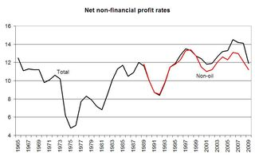
Figure 1: Industry Profit Rates (1966-2009)

Slide 5
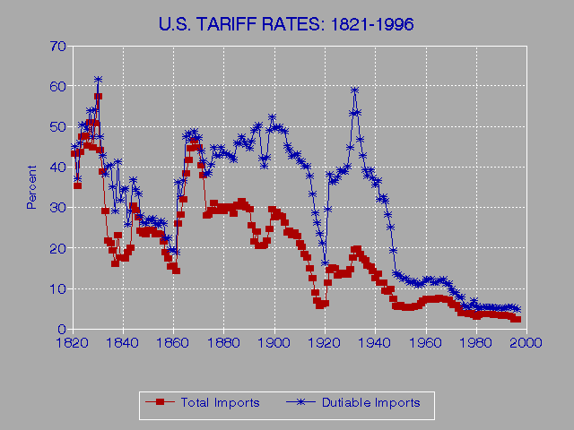
Figure 2: Tariff Rates Lowered

Slide 6
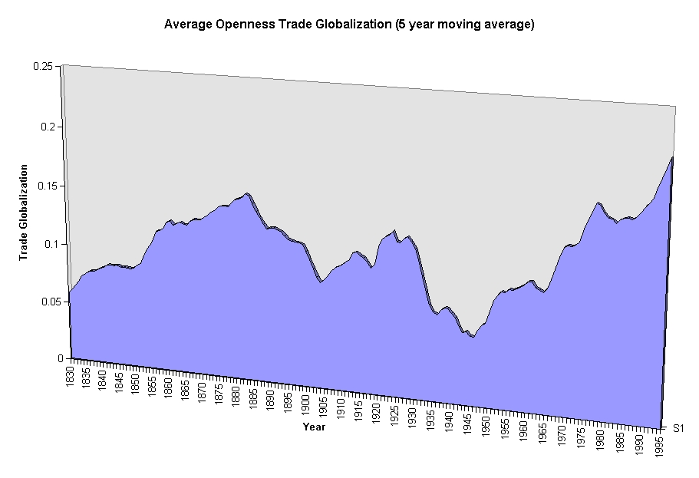
Figure 3: Market Access

Slide 7
Figure 4: GATT ROUNDS
Year Round Action
1947 Geneva 45,000 reductions in bilateral tariffs covering 20% of world trade.
1949 Annency, France 5,000 reductions in bilateral tariffs.
1951 Torquay, England 8,700 reductions in bilateral tariffs covering a new range of goods.
1955-56 Geneva Reductions in bilateral tariffs.
1960-62 Dillon Round Reductions in bilateral tariffs. EEC talks begin.
1964-67 Kennedy Round Reductions in bilateral tariffs. Negotiation rules established.
1973-79 Tokyo Round Reductions in bilateral tariffs. Procedures on dispute resolution, dumping and licensing.
1986-93 Uruguay Round Additional tariff reductions. Stalemate for agricultural tariffs.
1995 WTO established WTO replaces the GATT.
2001- Doha Round Divergences between developing and developed countries. Issues over agricultural subsidies.

Slide 8
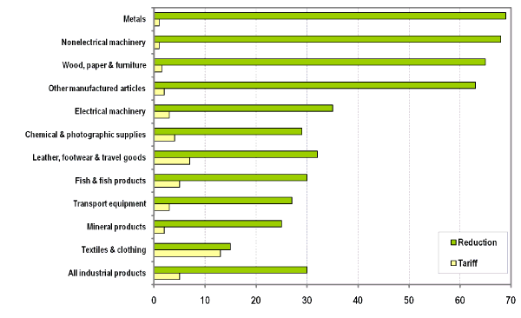
Figure 5: Uruguay Round (1986-93)(Average Tariff Reduction Worldwide)

Slide 9
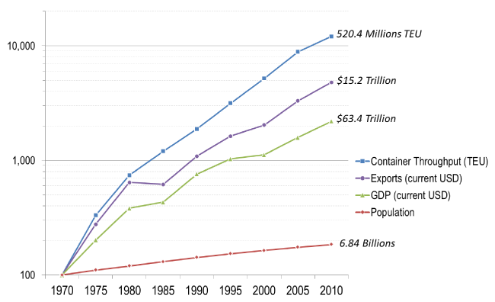
Figure 6: Containers and the Explosion of Trade

Slide 10
Politics in the 1970s:
1971: US Government abrogation of the 1944 Bretton Woods Agreement – shift from fixed to floating exchange rate for the US$. Why? Nixon Administration wanted to make US exports more competitive before 1972 presidential election. Beginning of “financialization” of the world economy: FOREX, money markets, worldwide derivatives markets, securitization of loans, etc. Removal of capital controls and floating exchange rates needed for all of these.

Slide 11
1973: OPEC oil price increases begin. Prices of basic resources (particularly oil) figure as major factor in world economy Second spike in 1979. Until 1960s US had supplied most of its own oil consumption.

Slide 12
CONSEQUENCES
Explosion of trade and FDI (Figures 7-8)
Initial lull in corporate profits as share of GDP in core followed by rapid recovery beginning in the 1980s alongside explosion of FDI (foreign direct investment) (Figures 9-11)
Financialization of the world economy following abrogation of Bretton Woods and loosening of national capital controls (Figure 12)

Slide 13
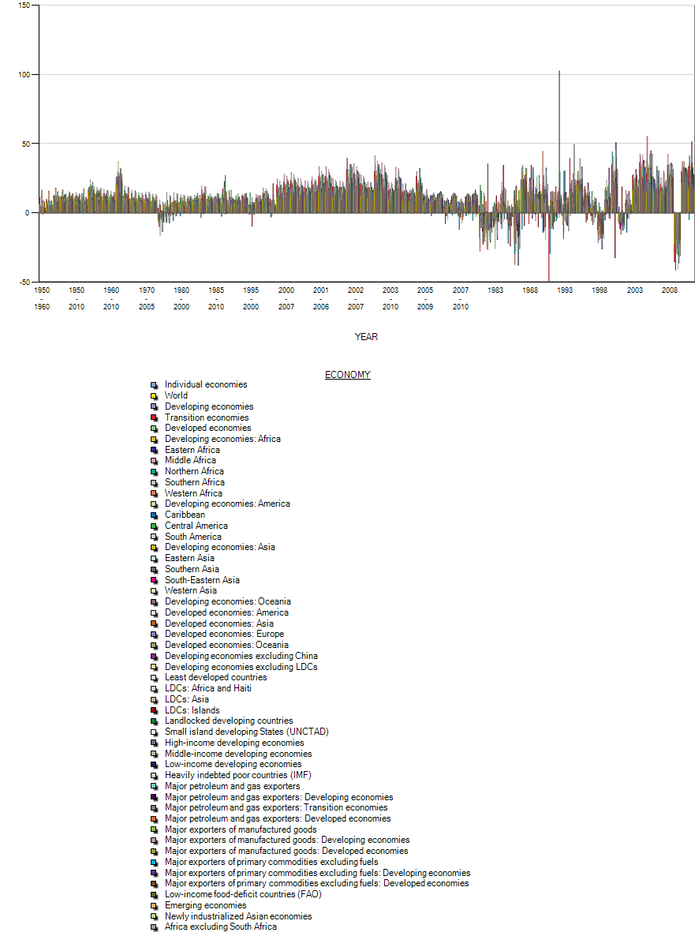
Figure 7: World Trade (1950-2011) Average Annual Rate of Growth

Slide 14
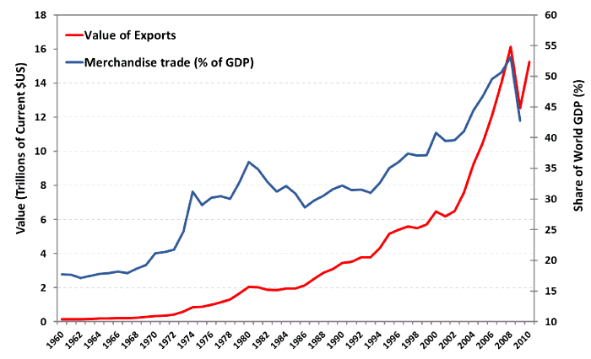
Figure 8: World Trade 1960-2010

Slide 15
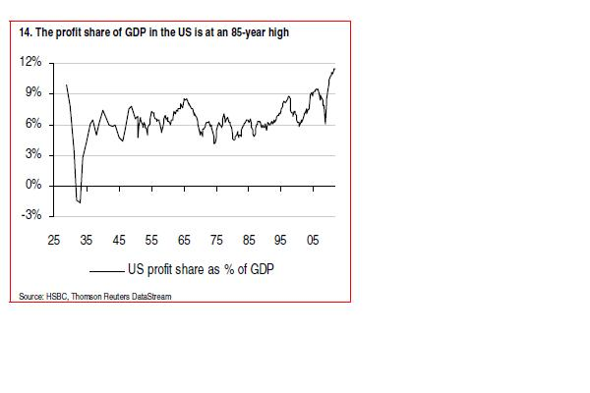
Figure 9: US Corporate Profits as Share of GDP (1925-2010)

Slide 16
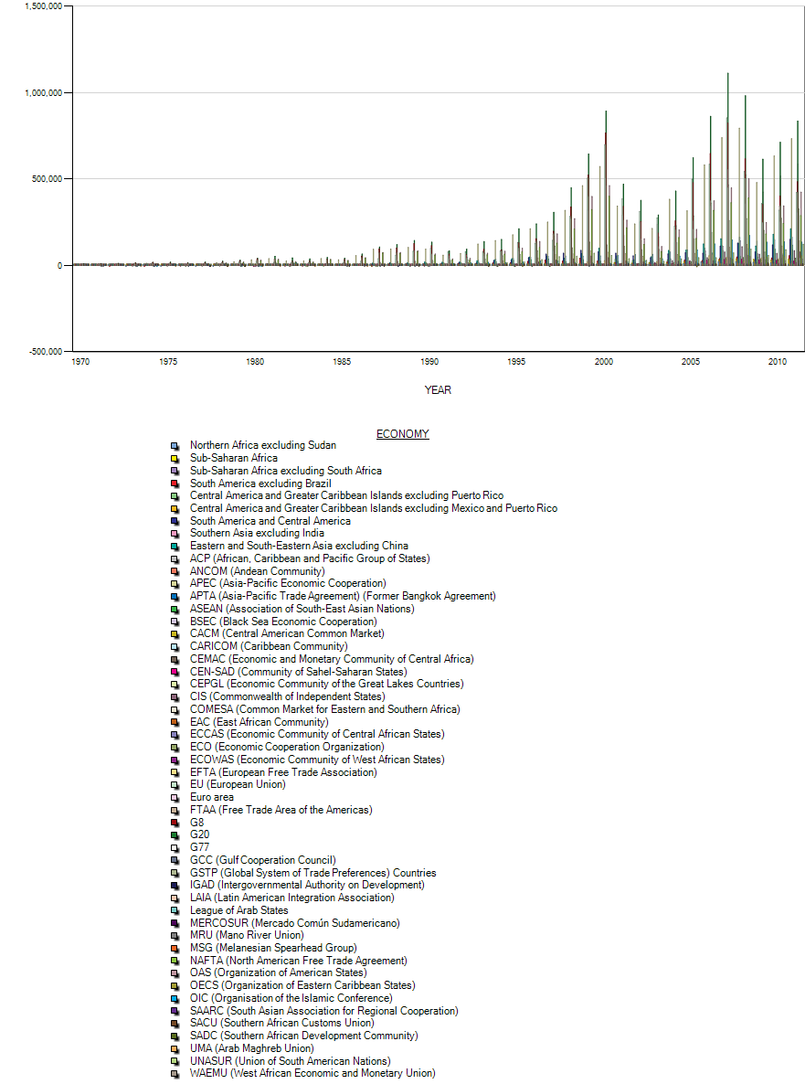
Figure 10: FDI worldwide (1970-2010) US$ millions

Slide 17
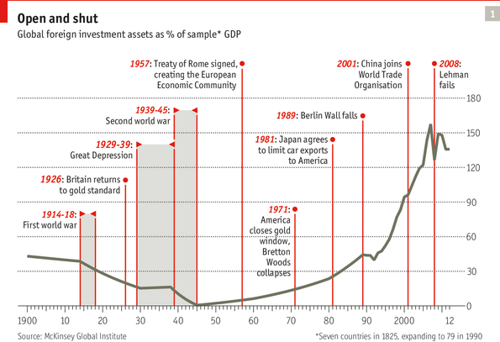
Figure 11: Foreign Investment Assets as % Global GDP

Slide 18
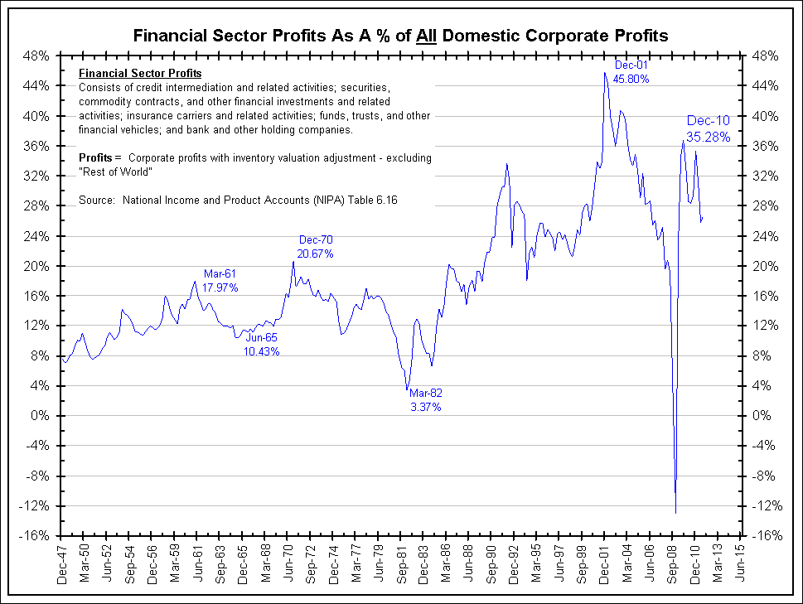
Figure 12: Financialization (US financial sector profits as share of all corporate profits)

Slide 19
Lecture 12: B. MULTINATIONAL FIRMS AND THE GLOBALIZATION OF PRODUCTION
Beginning of “Disorganized Capitalism” or Post-Fordism (Breakdown of government-business-labor collaboration in the core economies)
Recall: Declining rates of profit, increased trade openness, and more permissive financial environment following collapse of Bretton Woods.

Slide 20
Dealing with the profits crisis
1. Invest in new technologies and new products (substitute capital for labor and more niche markets for products– segmented labor and consumer markets)
2. Go multinational to benefit from different factor endowments/fiscal conditions (taxes, services) in different countries to build foreign market shares (concentration/saturation in home countries)

Slide 21
Three modes of going multinational:
1. Invest in foreign companies through M&A
2. Set up strategic alliances with foreign partners to carry out some phases of production offshore
3. Set up wholly-owned subsidiaries/branches in multiple locations

Slide 22
Incentives:
1. Lower production costs
2. Tax advantages of subsidiaries (e.g. transfer price invoicing to low tax jurisdictions) (Figures 13-16)
3. Macroeconomic benefits (exchange-rate differentials, tax rates)
4. Spread investment risk across countries

Slide 23
Figure 13: Transfer Price Invoicing: Tax and Jurisdiction
What is re-invoicing?
Re-invoicing is the use of a offshore corporation to act as an intermediary between an onshore business and his customers outside his home country. The profits of this intermediary corporation and the onshore business allow the accumulation of some or all profits on transactions to be accrued to the offshore corporation. Similar structure can be used also by an importer.
Use of re-invoicing - example
A corporation in high tax jurisdiction sells $500,000 of goods or services to Germany normally every year. Let’s say that cost of goods and operating expenses is $300,000. Corporation in high tax jurisdiction earns $200,000 on its sales before taxes. Taxes will average say $80,000 thus reducing net profits to $120,000. Let’s say that company from high tax jurisdiction establishes a offshore company to act as intermediary. The onshore company sells its goods and services to the offshore company for let’s say $320,000. This company immediately sells the goods and services to the German client for $500,000. The offshore company earns $180,000. Offshore corporation pays no taxes so $180,000 is net income. The exporting company in high tax jurisdiction shows minimal profit ($20,000). The $180,000 in tax-free income can be deposited in a bank account or other investment instrument according to the wishes of the onshore company.

Slide 24
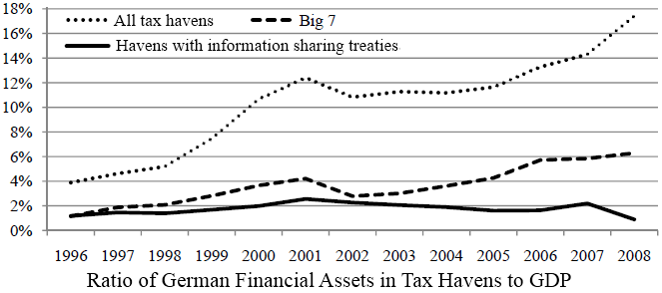
Figure 14: German Financial Assets to GDP Sheltered in Tax Havens

Slide 25
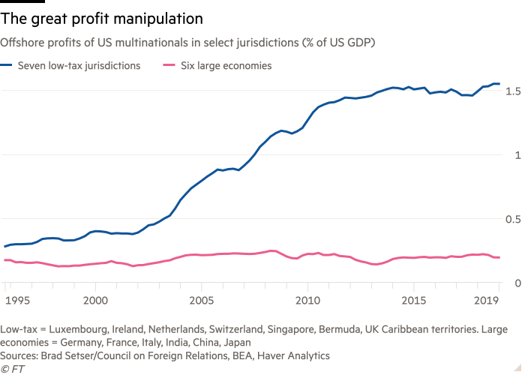
Figure 15: US firms hide profits in low-tax jurisdictions

Slide 26
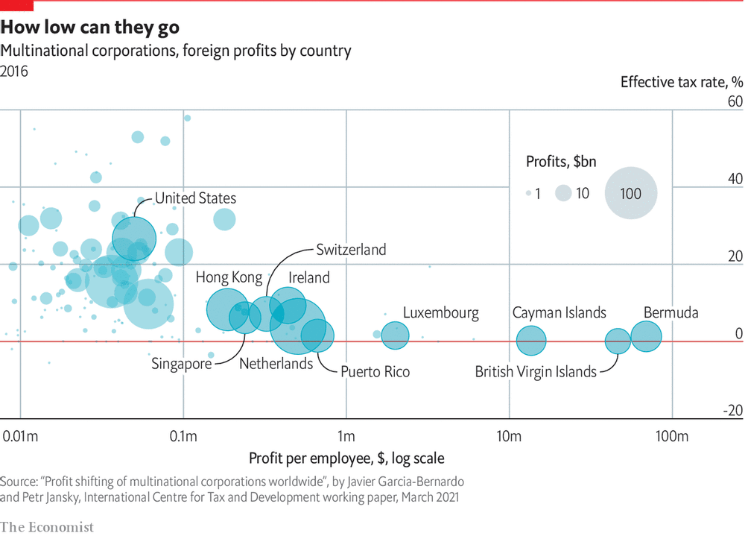
Figure 16: Tax avoidance and lost revenues

Slide 27
CONSEQUENCES FOR THE WORLD ECONOMY SINCE THE 1970s
1. Biggest firms are now mainly multinational or transnational. Biggest firms dominate in the world economy (see Figure 17-19)
2. Rise of tax havens to shelter profits (see above)
3. Majority of FDI still barely between core countries with rise of China, SE Asia and Brazil (as of 2020 50% compared to 80% in 1995).
4. Product life cycle model and relocation of labor-intensive production based on factor endowment (see Figure 20)
5. Massive share of international trade today WITHIN firms with factories located across the world (Figure 21)

Slide 28
6. Global supply chains with components from multiple sites and several assembly sites (as world gross trade volume has increased the VAX -- Ratio of value added to gross trade – which went up enormously in the 1970s and 1980s has recently tended down, indicating that value added during trade has gone down somewhat – even though much trade is still of components NOT final products; Chinese consumption of raw materials beginning in the 1990s eclipsed the previous trend which, however, has started to go up again) (Figure 24). Overall, it is still harder to identify the specific “nationality” of products. Take the case of Apple products (Figures 21-26).

Slide 29
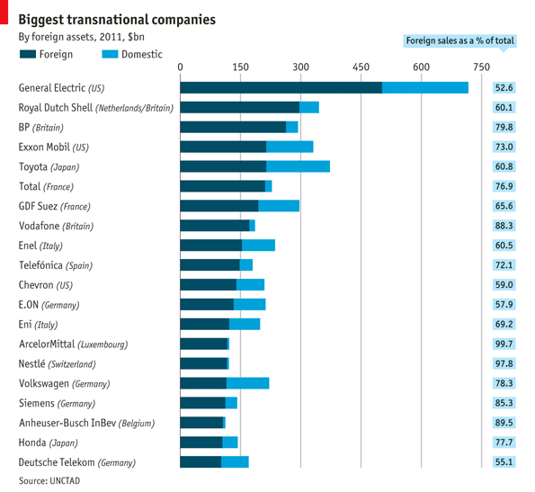
Figure 17

Slide 30
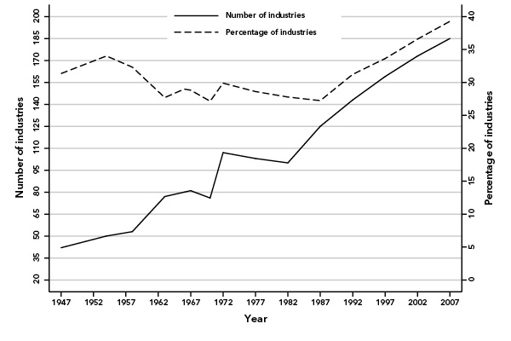
Figure 18: US 1947-2007 (as of 2007, close to 40% of all industries in the US had four firms or less with 50% of all production )

Slide 31
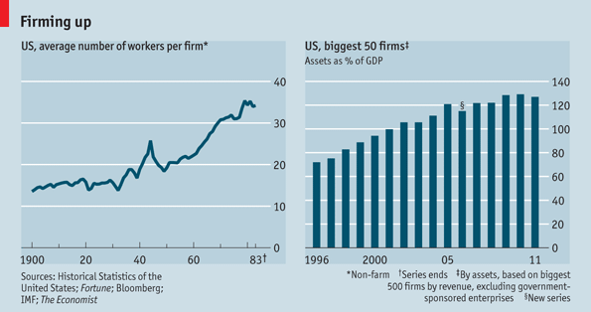
Figure 19: US Firms Keep Getting Bigger

Slide 32
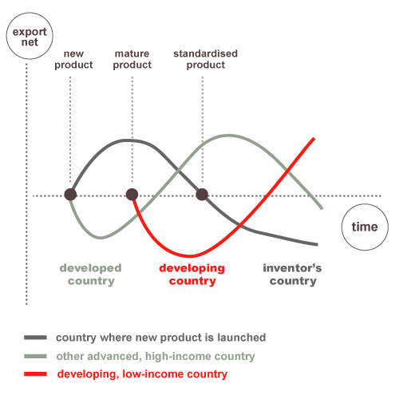
Figure 20:Product Life-Cycle Model

Slide 33
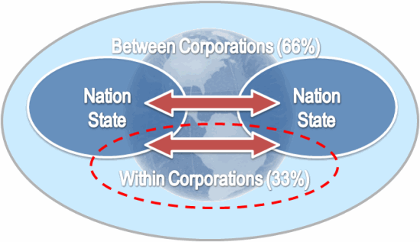
Figure 21

Slide 34
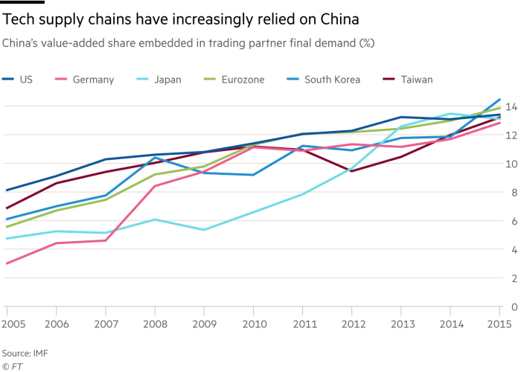
Figure 23

Slide 35
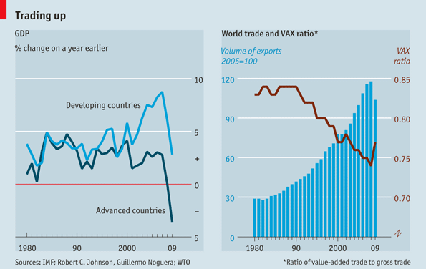
Figure 24: Increased share of world trade is in parts and components not just resources and finished goods. These move through global supply chains within the borders of firms.

Slide 36
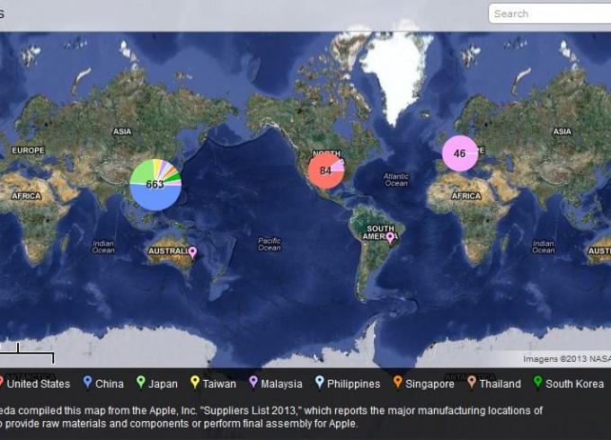
Figure 25: Apple Suppliers by Location and Numbers of Employees

Slide 37
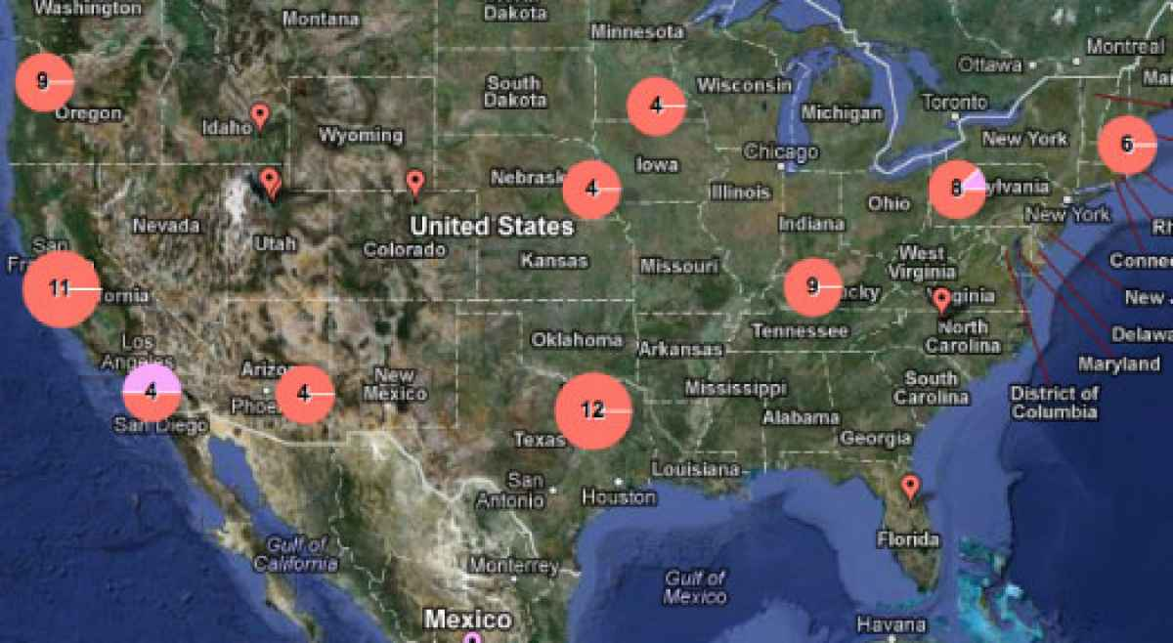
Figure 26: Apple Parts Contractors in the US. Not just “Made in China”

